Slide 1
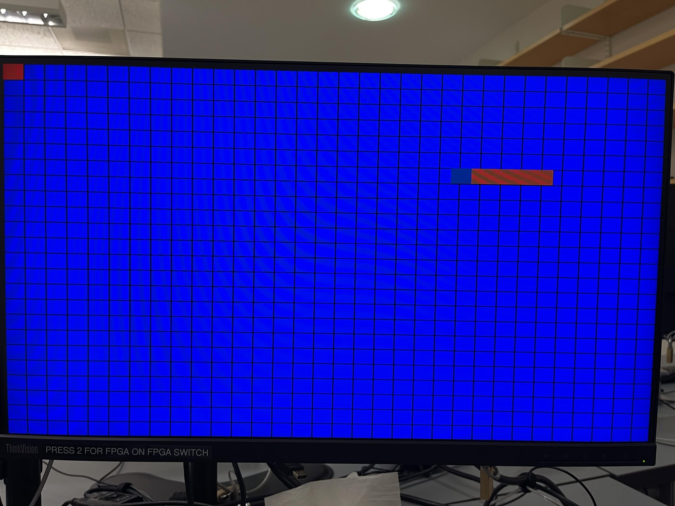
Team 13:
Snake
Yoel Beyene, Erbyn Bonilla, Ivan Isakov, William Nilsen

Slide 2
Goal/Motivation
Our goal was to reproduce one of the most entertaining games in computer history (snake). It was a suitable idea to implement it on the FPGA, because it had all the necessary components.
Also, this way we had the whole game on a single chip, which means that we have a device with minimal speed issues, which we could have had if instead we had made it in software on a microcontroller
We wanted our final product to be a simple game that anyone (who owns a compatible FPGA) can sit down and play.

Slide 3
Short Functionality
The design is supposed to get an input from the keyboard, which is the direction in which you want the snake to go. Then it will be processed by the movement module to output the next position of the snake, which will be displayed on the screen through the VGA.
The objects for the snake to eat will appear at random positions on the screen. In order for the snake to get longer, the snake must pass over and “eat” the objects (apples). And if the snake goes out of bounds or will run into itself the game will end.

Slide 4
Short Specification
Our design would use a keyboard, but to keep things simple we would only need 4 buttons (i.e. the arrow keys) to determine the movement of the snake
We used VGA for visuals, so we needed to abide by the 640x480 pixel requirements for our graphics. We decided that each square in the game board should take up a 20x20 pixel area, giving us 32x24 spaces to work with
We also decided that, while the VGA would require a 25MHz clock, we would update the game pieces 4 times a second (4 Hz) so that it would take 8 seconds for the snake to move all the way from the left side of the screen to the right side.

Slide 5
Blockade Variant Game Design
Module: VGA Display
Module: Lose Condition
Module: Objective Generator
Module: Body & Head Module
VGA Refresher
H-Sync & V-Sync are outputs
Head hits either body or border
Keyboard inputs; Up, Right, Down, Left using OP code
Generates an objective in a random position within display
25 MHz
RGB to illustrate “snake”, objective, and border
Red, Green, Blue as outputs
Resets the score and the body segments obtained
As head moves, its bits are shifted to the body to simulate movement
Generates a new objective after old objective has been obtained
Resets head back to the starting position with a new objective
As score goes up, new segments of the body are illustrated
Maintains a score of how many objectives were maintain
Clock Divider Module -Input
4 Hz

Slide 6
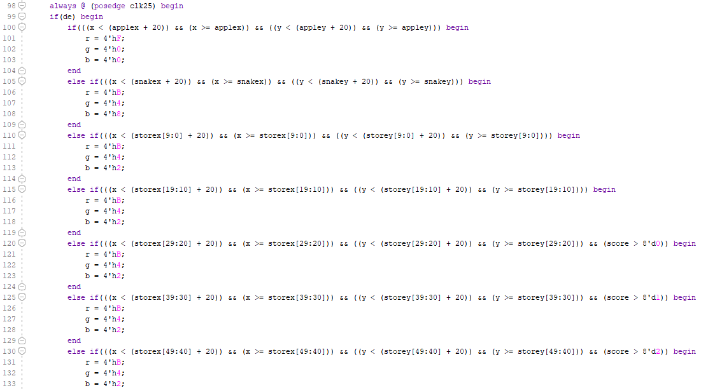
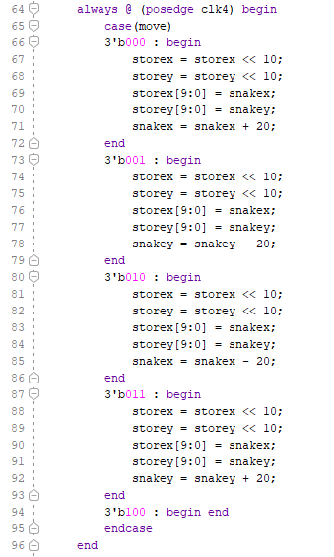
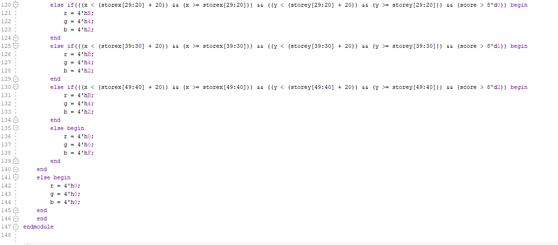
Code Snippets

Slide 7
Successes
We were able to successfully get the keyboard input to work which would be the player controlled part
We also successfully got our game to display through VGA on the lab monitor after hours of testing and debugging

Slide 8
Failures
We spent so long fixing the VGA that we couldn't improve our snake game as much as we wanted to once we had finished the base project.
We are experiencing occasional graphical oddities/glitching
We are having issues with the apple collision detection, which is making it difficult to both play the game and to test our more advanced features

